Slide 1
Predicting housing prices with Linear regression
Data Analysis project

Slide 2
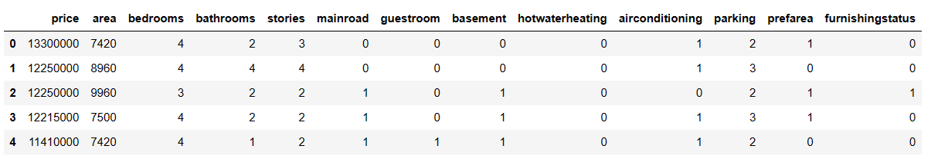
Introduction to the dataset
Build a predictive model for estimating the housing prices.
Dataset has the following attributes

Slide 3
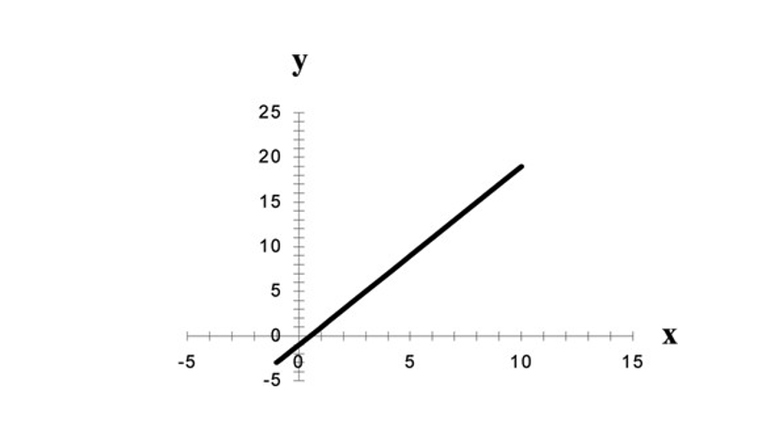
Simple linear regression
Selected Area as the independent variable(x).
Implemented simple linear regression model to predict housing prices based on the Area.
Mean Square Error(MSE) – 2192849709977.5737
Root Mean Square Error(RMSE) – 1480827.3734563303
R Square – 0.025511460220571158
Mean Absolute Error(MAE) – 1137988.1572999794

Slide 4
Interpreting r – square value
Based on the R-Square value it indicates only 2.55% of the variation I housing prices.
i.e. “Area” alone has a limited ability to predict house prices.
Based on this model’s performance ,predicting housing prices based on area is poor fit

Slide 5
multiple linear regression
Selected Area, Bedrooms, Bathrooms, Stories as the independent variables(x).
Implemented simple linear regression model to predict housing prices based on the Area, Bedrooms, Bathrooms, Stories.
Mean Square Error(MSE) – 1371950575123.3716
Root Mean Square Error(RMSE) – 1171302.9390910668
R Square – 0.5560515953913245
Mean Absolute Error(MAE) – 848551.0453361191

Slide 6
Advantages of using multiple features
Better prediction : -We get clear picture of housing prices.
Understanding complexity :- Different factors working together will impact on prices.
Realistic predictions :- Mirror how things work in realistic world.
Better at guessing :- Making wide range of scenarios.

Slide 7
Modle conclusion
Simple Linear Regression
Advantages:
Easy to Understand: It’s simple and easy to grasp because it looks just one thing at a time.
Clear Explanation: Easy to explain how one thing affects another in straightforward way.
Multiple Linear Regression
Advantages:
Complete Picture: Looking at many things together for giving us better understanding of how everything works together.
Realistic : It aligns with the more complexity problems in real world.

Slide 8
Modle conclusion
Simple Linear Regression
Limitations:
Only One Piece: It can’t handle the full picture when many things affect the result.
Too Simple: In real life many factors are usally at play where simple linear regression cannot handle that complex situations.
Multiple Linear Regression
Limitations:
Gets Complex: While using more factors this model can became more complicated and might need lot data to work well.
Assumes Linearity: The relatiionships are linear but that’s not always the case in real world.

Slide 9
Summary
"In this project, we explored simple and multiple linear regression to predict house prices, showcasing the advantages of multiple features for realistic and accurate predictions."

Slide 10

Any questions ?

Slide 11

Thank you

